Slide 1
Presenter: Kyle
Stock Trading System
Final Build Deck
IFT 401 Information Technology Capstone, Fall 2026
Daniel Houser, Alex Ruebush, Kyle Kishineff
November 2026
Notes:
Hi everyone, I'm Kyle Kishineff. With Daniel Houser and Alex Ruebush, this is the final build of our Stock Trading System for IFT 401. Everything you'll see in this deck and in our video is running live on AWS.

Slide 2
Presenter: Kyle
Agenda
Our solution, stakeholders and team
Architecture on AWS and our tools
Build vs. design
Every business function, demonstrated
Deployment, security and testing
Biggest accomplishment, problems, limitations and lessons learned
Notes:
We'll start with the solution, who it's for and who built what. Then the architecture we deployed on AWS and the tools we used, and where the build changed from our design. The biggest part is every business function from the business case, each with a screenshot from the live site. Then deployment, security and testing, and we close with the problems we solved, the limits we know about, and what we learned.

Slide 3
Presenter: Kyle
Our technology solution
In one sentence
A web-based stock trading simulator where stockbrokers in training buy and sell stocks at randomly moving market prices, and administrators create stocks and control market hours.
Live on AWS: http://54.92.198.76 | Web front end, Node.js REST API, PostgreSQL on Amazon RDS
Notes:
In one sentence: our solution is a web-based stock trading simulator where stockbrokers in training buy and sell stocks at randomly moving market prices, and administrators create stocks and control market hours. It's a client/server application with web pages, a Node.js REST API and a PostgreSQL database, and it's live on AWS at the address shown.

Slide 4
Presenter: Kyle
Stakeholders and target audience
Customers (target audience)
Stockbrokers in training. They create an account, buy and sell at market price, cancel pending orders, manage cash, and review their portfolio and history.
Administrators
Create stocks with a company name, ticker, volume and initial price, and control market hours, the weekday schedule and holidays.
The company and its IT department
The company needs a safe way to train brokers without real money at risk. IT designs, builds, hosts and maintains the system.
Instructor and course staff
Evaluate whether the build meets the business case and matches the design we documented in the SAD.
Notes:
Our target audience is stockbrokers in training, the customers. Administrators create stocks and control the market hours and schedule. The company sponsors the project because it needs a safe way to train brokers with no real money at risk, and its IT department builds and runs the system. Our instructor and course staff evaluate the build against the business case and our SAD.

Slide 5
Presenter: Kyle
Team and roles
Who built what
Member | Role | What they built
Daniel Houser | Front-end lead | Every web page (stock listing, account, login, buy, sell with cancel, deposit and withdraw, portfolio, history, create stock, market hours) and the api.js client that connects the pages to the real API
Alex Ruebush | Data lead | database schema and seed data, account creation, bcrypt password hashing, jwt authentication, /users/me, cash deposit and withdrawal routes, portfolio route, transaction history route, and administrator stock creation.
Kyle Kishineff | Infrastructure and cloud lead | Development environment, stock listing API, random price generator, market hours and schedule, orders with cancel and the order executor, integration tests, AWS deployment, deck and video
Notes:
Daniel led the front end and built every page plus the api.js client that connects them to our API. Alex led the data side: the ERD and schema, account creation, login with JWT tokens, and the cash routes. I led infrastructure and cloud: the development environment, the price generator, market hours, orders and the order executor, our integration tests, and the AWS deployment. (Kyle: update Alex's row once create stock, portfolio and transactions are merged.)

Slide 6
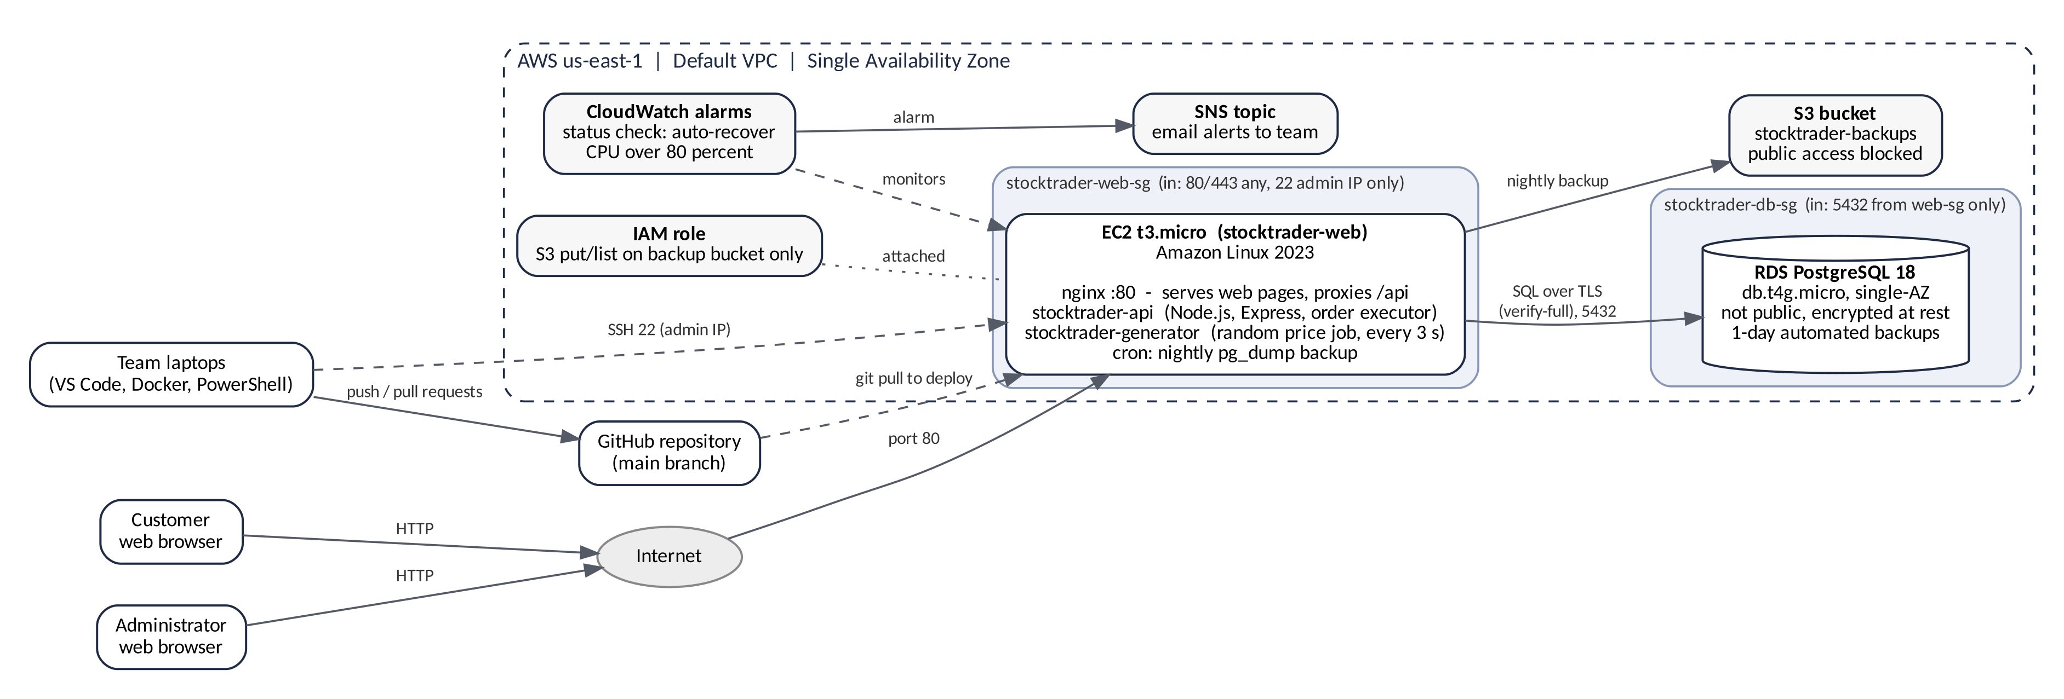
Presenter: Kyle
Architecture as deployed on AWS
AWS Free Tier, us-east-1, single Availability Zone
One EC2 instance runs nginx, the API with its order executor, and the price generator. The database is private and only accepts connections from the web server.
Notes:
This is what we actually deployed. A browser reaches one EC2 t3.micro instance on port 80. nginx on that instance serves the web pages and passes anything under /api to our Node.js API on port 3000, which also runs the order executor. The price generator runs next to it as its own service. Both are systemd services, so they start at boot and restart if they crash. The database is RDS PostgreSQL 18. It isn't public: its security group only accepts the web server, and the connection uses TLS. Every night a cron job dumps the database to a private S3 bucket. CloudWatch watches the instance, recovers it automatically if it fails a status check, and emails us through SNS. To deploy, we pull from GitHub on the server and restart the services.

Slide 7
Presenter: Kyle
Development tools and environment
Layer | What we use | Why we chose it
Languages | JavaScript (Node.js 22), HTML, CSS, SQL | One language on the server and in the browser; SQL fits relational trade data
Back end | Express, pg, bcryptjs, jsonwebtoken | Quick REST API; bcrypt hashes passwords; JWT gives stateless login
Database | PostgreSQL 16 in Docker Compose (local), PostgreSQL 18 on Amazon RDS | ACID transactions keep orders, holdings and cash consistent; same setup for every teammate
Front end | Static HTML, CSS and JavaScript pages | No framework; one api.js file talks to the API
Collaboration and testing | GitHub branches and pull requests, VS Code, PowerShell and Postman, Discord, integration test suite | Reviewed merges stop overwrites; routes are tested without the front end
Hosting | EC2 with nginx and systemd, RDS, S3, CloudWatch, SNS, IAM | Fits the AWS Free Tier and matches our SAD
Notes:
We wrote everything in JavaScript on Node.js, with plain HTML and CSS pages and SQL for the database. The API uses Express, bcryptjs for password hashes and jsonwebtoken for login. Locally, PostgreSQL runs in Docker Compose so all three of us have an identical database; in production it's PostgreSQL 18 on RDS. We worked through GitHub branches and pull requests, edited in VS Code, tested routes in PowerShell and Postman, and kept an integration test suite. Hosting is EC2 with nginx and systemd, plus RDS, S3, CloudWatch and SNS.

Slide 8
Presenter: Kyle
Our environment in action
SCREENSHOT
GitHub: Pull requests > Closed, showing PRs #1 to #7 merged (or Insights > Contributors). Crop out anything private.
SCREENSHOT
AWS console: EC2 Instances list with stocktrader-web Running and 2/2 checks passed, plus RDS Databases with stocktrader-db Available. Hide the account ID in the top-right menu.
Every change went through a pull request
The production stack running on AWS
Notes:
On the left, our merged pull requests: every change went through a feature branch and a reviewed merge. On the right, the production stack in the AWS console: the web server running with both status checks passing, and the database available.

Slide 9
Presenter: Kyle
Build vs. design
What changed from the SAD, and why
Area | SAD plan, then what we built | Why we changed it
Price generator | Planned as an EventBridge-scheduled job. Built as a systemd service on the EC2 instance that runs every 3 seconds. | No extra AWS service; the same code runs on a laptop and on AWS; systemd restarts it if it stops
Web serving | Planned the API and pages on one instance. Added nginx in front: it serves the pages and proxies /api to Node. | One address for pages and API; the API port is never exposed
Domain and HTTPS | Planned Route 53 and HTTPS. Running on the instance's public IP over HTTP. | No domain registered; documented as an MVP limitation with a fix
Placing orders | First API draft filled orders instantly. Orders are saved as pending and a server timer fills them. | The business case lets a customer cancel before execution
Unchanged | Three tiers, one EC2 instance, single-AZ RDS, S3 backups, CloudWatch alarms, customer and admin roles. | The build matches the design in structure
Notes:
In structure the build matches our SAD: three tiers, one EC2 instance, a single-AZ RDS database, S3 backups and CloudWatch alarms. We made four deliberate changes. The price generator was planned as an EventBridge job; we run it as a service on the same instance, which needed no extra AWS service and runs identically on a laptop. We added nginx so the pages and API share one address and the API port is never exposed. We planned Route 53 and HTTPS but didn't register a domain, so the site runs on HTTP, which we document as a limitation. And orders are saved as pending and filled by a timer, because the business case requires that a customer can cancel.

Slide 10
Presenter: Kyle
Business functions delivered
Every function in the business case, as of November 7, 2026
Function | Back end / front end | Status
View available stocks (price, volume, market cap, open, high, low) | Kyle / Daniel | Live
Create a user account | Alex / Daniel | Live
Log in | Alex / Daniel | Live
Buy and sell stock at market price | Kyle / Daniel | Live
Cancel an order before it executes | Kyle / Daniel | Live
Deposit and withdraw cash | Alex / Daniel | Live
View portfolio of stocks and cash | Alex / Daniel | Live
View transaction history | Alex / Daniel | Live
Create a new stock (admin) | Alex / Daniel | Live
Change market hours and schedule (admin) | Kyle / Daniel | Live
Random stock price generator | Kyle | Live
Notes:
This is every function the business case asks for and where each one stands. (Kyle: update the status column to Live as each of Alex's routes is merged and redeployed, and say plainly in the video which ones aren't finished, if any.)

Slide 11
Presenter: Daniel
Function: View available stocks
What it does
Fill in: what the customer sees (ticker, company, price, change, volume, market cap, and open, high and low for the day).
How it works
Fill in: the page calls GET /stocks, how often it refreshes, and that market cap is volume x price.
Checks
Fill in: what the page shows when the market is closed or the API can't be reached.
SCREENSHOT
Live AWS site home page with the stock table, and one row clicked so its open, high and low show. Keep the browser address bar in the shot so the AWS address is visible.
Notes:
Daniel, what to say: show the stock list on the live AWS site, point out a price changing between refreshes, click a row to show open, high and low, and say where the numbers come from (the real database, not mock data).

Slide 12
Presenter: Daniel
Function: Create a user account
What it does
Fill in: the fields a new customer enters, and that new accounts start with $0.00 cash.
How it works
Fill in: the page calls POST /users; the password is stored as a bcrypt hash and never returned.
Checks
Fill in: duplicate username or email returns 409, missing fields return 400, and the form's own checks.
SCREENSHOT
Create Account page on the live site with the form filled in (full name, username, email, password) and the green success message after submitting.
SCREENSHOT
Same page after submitting a username that already exists, showing the red duplicate error.
Notes:
Daniel, what to say: register a brand new user on the live site, then try the same username again to show the error. Mention Alex built the API side and the password is hashed.

Slide 13
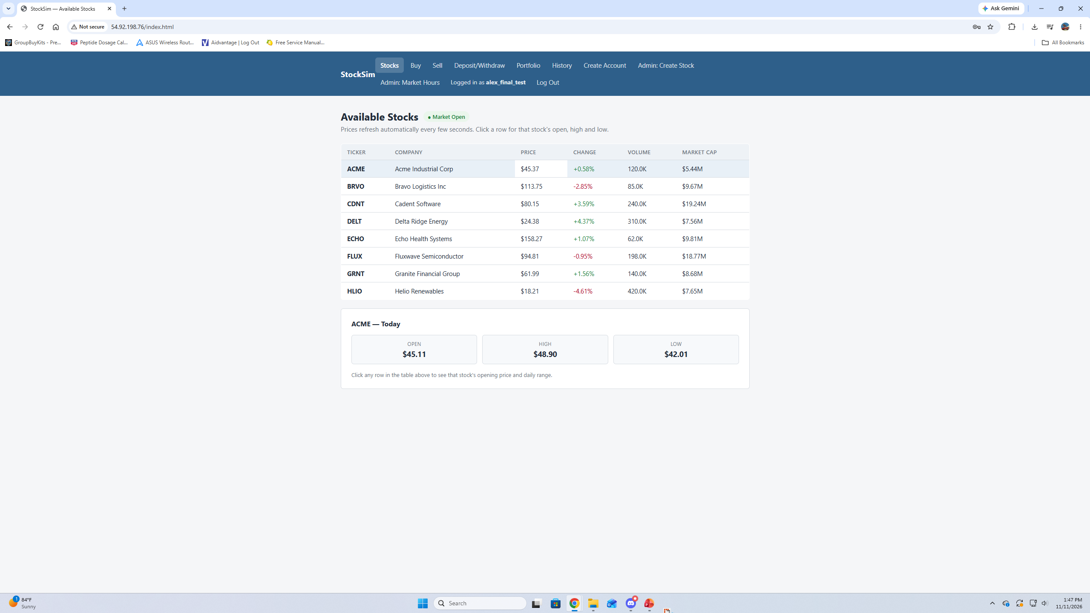
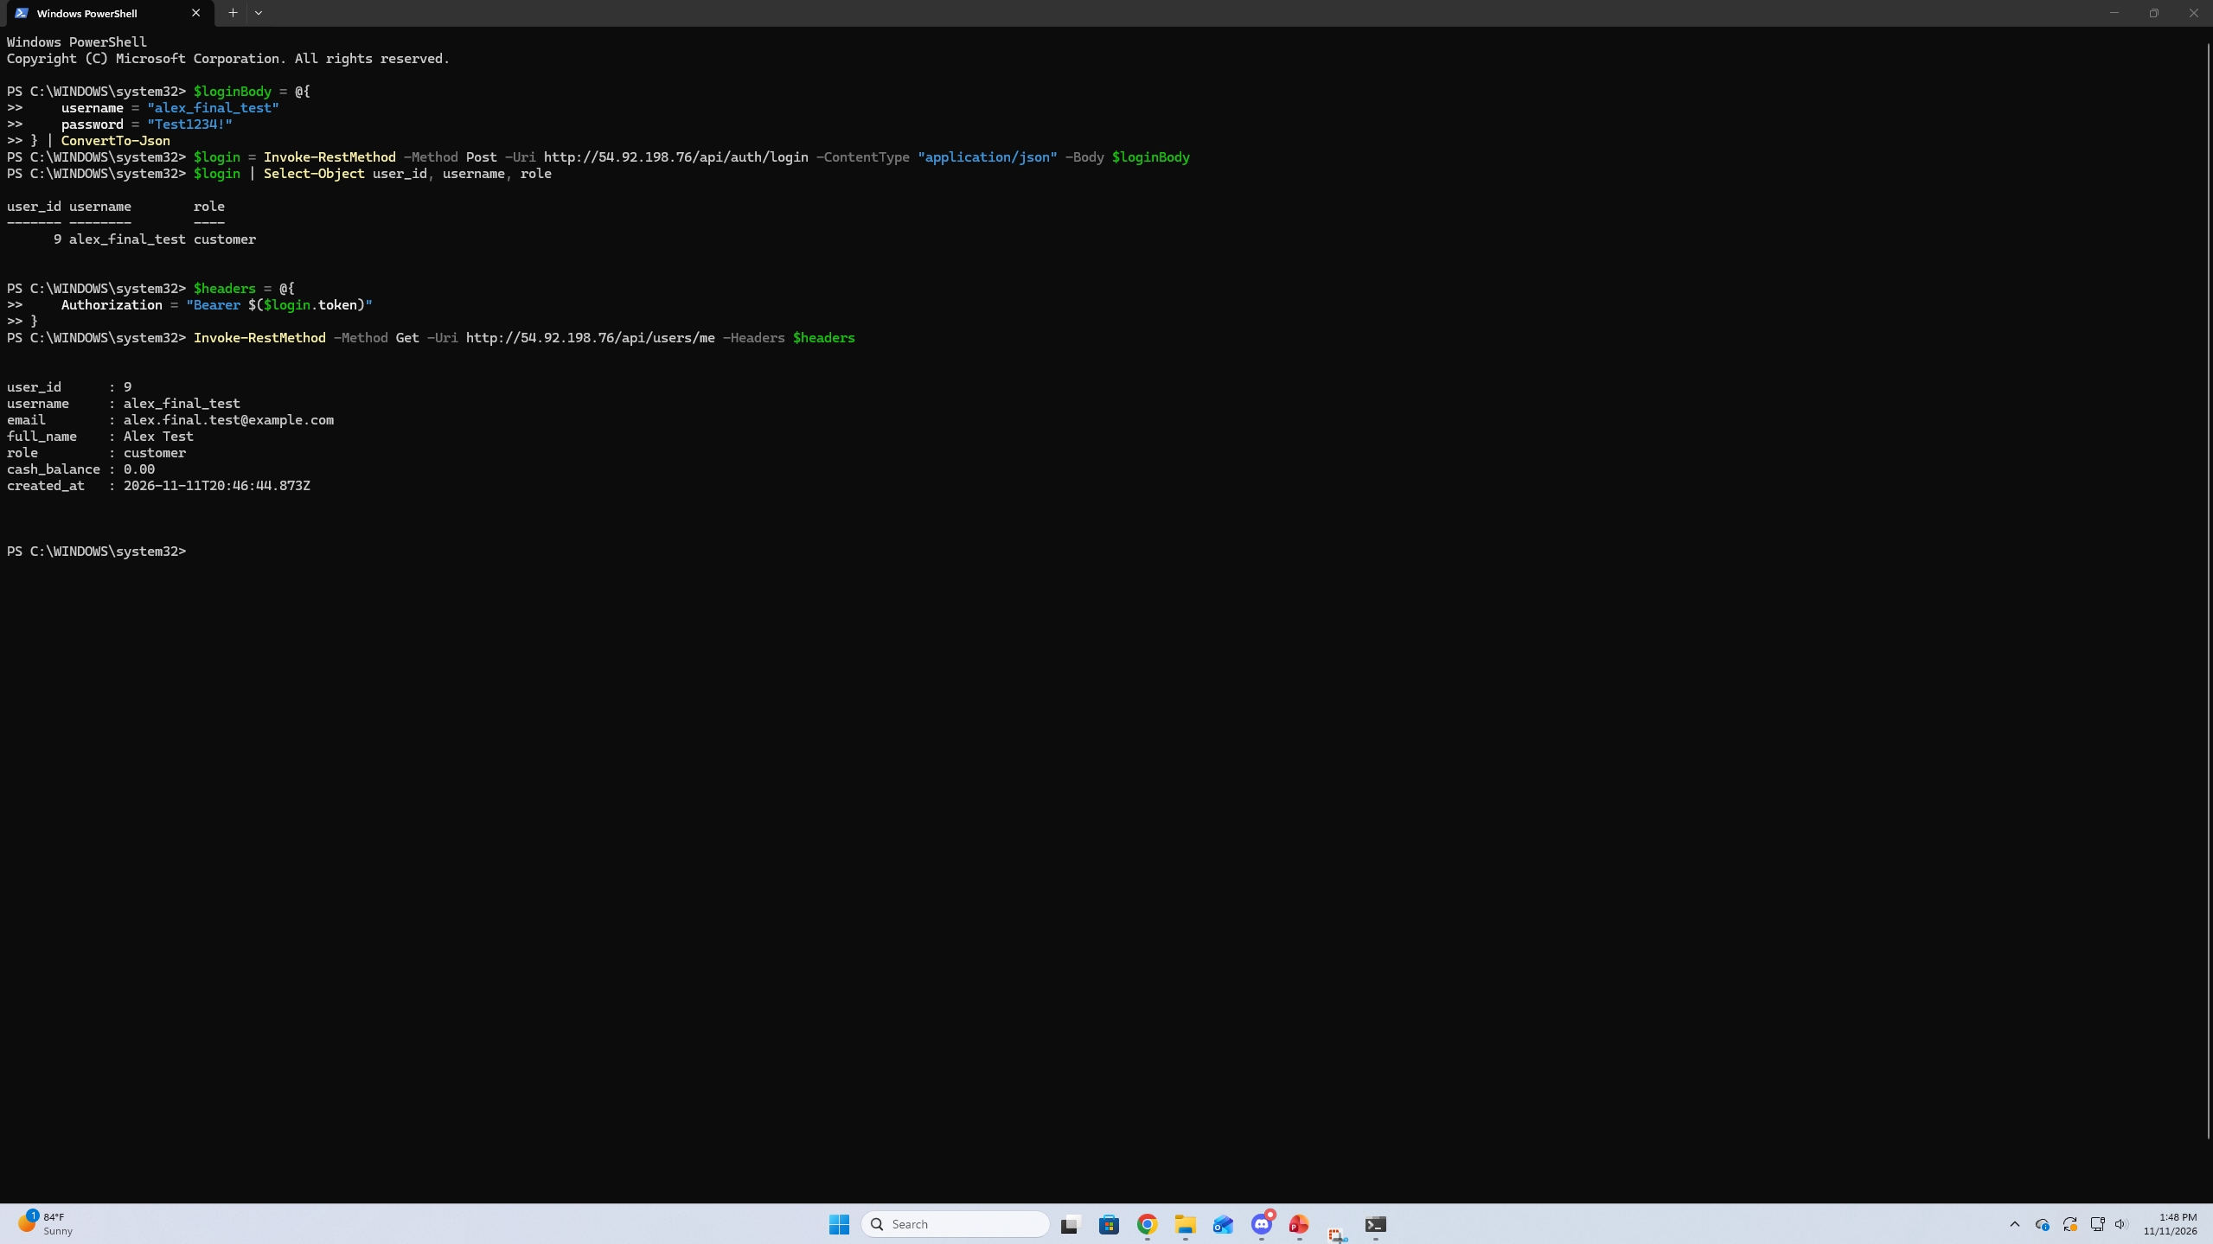
Presenter: Alex
Function: Log in
What it does
Fill in: Registered customer or administrator can log in securely to Stock Trading System. After logging in, user stays authenticated while visiting secured pages and displays account info like username, role and cash balance.
How it works
Fill in: POST /auth/login authenticates the username and checks the password against the bcrypt hash. Returns a JWT with the user id and role on successful login. Token is provided in Authorization header on requests to secured endpoints. GET /users/me returns the authenticated user's account.
Checks
Fill in: 401 Unauthorized is returned on bad usernames or passwords. Missing, invalid or expired tokens will also return 401. Valid customer tokens will be returned 403 Forbidden if they try to access a route restricted to administrators only.
Notes:
Alex, what to say: log in on the live site, then show the login and /users/me calls and a 401 for a bad password. Never show a full token on screen.

Slide 14
Presenter: Daniel
Function: Buy and sell stock at market price
What it does
Fill in: a customer picks a stock and quantity and buys or sells at the current market price; sale proceeds go to the cash account.
How it works
Fill in: the page calls POST /orders; the order is pending for a few seconds, then filled at the price at that moment.
Checks
Fill in: not enough cash or shares, or a closed market, rejects the order with a reason.
SCREENSHOT
Buy page on the live site with a buy order just placed and shown as pending, with the cancel countdown visible.
SCREENSHOT
Order history or portfolio after the order fills: status Executed, the fill price, and the cash balance lowered by the cost. Add a sell the same way if there's room.
Notes:
Daniel, what to say: buy a few shares on the live site, point out the pending status and countdown, wait for it to fill and show the cash going down, then sell and show the cash going back up. Kyle covers cancel on the next slide.

Slide 15
Presenter: Kyle
Function: Cancel a pending order
What it does
A customer can cancel a buy or sell while it is still pending. Orders that are not canceled fill a few seconds later at the price at that moment.
How it works
POST /orders saves the order as pending with an execution time. A timer in the API checks every second, locks each due order, rechecks market hours, then moves the cash and shares and writes the transaction in one database transaction.
Checks
Only pending orders can be canceled. Row locks stop a cancel and a fill from both happening. Too little cash or shares, or a closed market, rejects the order with a reason.
SCREENSHOT
Buy page on the live site right after clicking Cancel during the countdown, showing the order as Canceled.
SCREENSHOT
SSH terminal on the EC2 server running: journalctl -u stocktrader-api -n 20 --no-pager, showing "Order ... executed" lines from the executor.
Notes:
The business case says a customer can cancel an order before it executes, so orders can't fill instantly. When a customer places an order, the API saves it as pending with an execution time a few seconds out. Here I place an order and cancel it during the countdown, and it shows as canceled and never fills. Behind the scenes, a timer inside the API runs every second. For each order that's due, it locks the order row, checks the market is still open, reads the current price, and moves the cash and shares in a single database transaction. That lock is what makes a cancel and a fill at the same instant safe: one of them wins and the other sees the order is already done. Here are the executor's log lines on the AWS server.

Slide 16
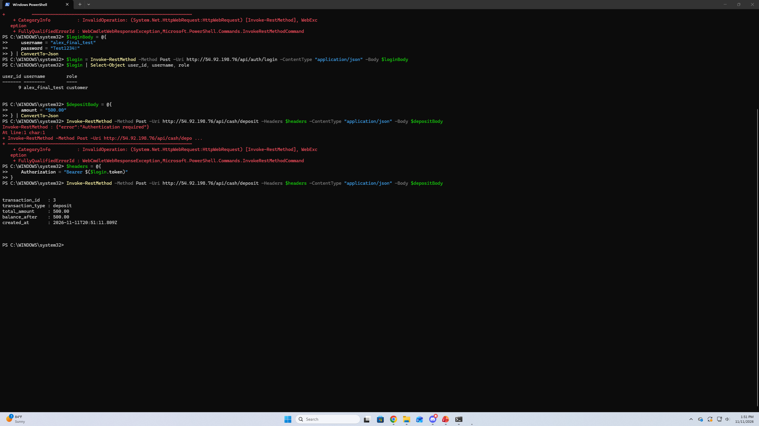
Presenter: Alex
Function: Deposit and withdraw cash
What it does
Fill in: Customers may deposit to and withdraw from their cash account. Customers cannot overdraw their account.
How it works
Fill in: The Deposit/Withdraw page POSTs to /cash/Deposit and /cash/Withdraw. Each successful request increases/decreases the customer's cash account balance and atomically adds a transaction record to PostgreSQL.
Checks
Fill in: Deposits and withdrawals must be greater than 0. Withdrawals that would overdraw the account return 409 Insufficient Funds. Unauthenticated requests return 401 Unauthorized.
SCREENSHOT
Deposit/Withdraw page on the live site after a deposit, showing the new cash balance and the success message.
Notes:
Alex, what to say: deposit on the live site and show the balance change, then try to withdraw too much and show it's refused. Mention every deposit and withdrawal also writes a transaction row, which feeds the history page.

Slide 17
Presenter: Daniel
Function: Portfolio and transaction history
What it does
Fill in: what the customer sees on each page (holdings and cash; a list of past transactions).
How it works
Fill in: which routes each page calls (GET /portfolio and GET /transactions once Alex merges them) and how often they refresh.
Checks
Fill in: what shows for a new customer with no holdings or no history yet.
SCREENSHOT
Portfolio page on the live site showing holdings (ticker, shares, average cost, current value) and the cash balance.
SCREENSHOT
Transaction History page listing recent buys, sells, deposits and withdrawals with dates and amounts.
Notes:
Daniel, what to say: open the portfolio after the buys and sells you just did and show the numbers match, then open the history page. If either route isn't merged by recording day, say so plainly instead of showing mock data.

Slide 18
Presenter: Alex
Function: Create a new stock (admin)
What it does
Fill in: An admin is able to add a new tradable stock by simply providing the company name, ticker symbol, initial price, and initial volume. After creation, the stock is viewable by customers on the stock listing page.
How it works
Fill in: POST /stocks is limited to administrators. When a stock is created, its current price, open price, day high, and day low are initially set to that of the administrator's initial price. The administrator will also set the starting volume for that stock. Once created, every successful buy will increment the stock's volume by the amount of shares bought. Sell orders do not decrement volume. Market Capitalization is determined by the stock's current price multiplied by its volume.
Checks
Fill in: Sending invalid prices or volume values will give a 400 Bad Request response. If you try to create two identical tickers, you will get a 409 Conflict response. Trying to create a stock as a logged-in customer will return 403 Forbidden. If the token is missing or invalid 401 Unauthorized will be returned.
SCREENSHOT
Create Stock page, logged in as an admin, with company name, ticker, volume and initial price filled in and the success message.
SCREENSHOT
Stock listing page afterward with the new stock showing, its open, high and low all equal to the initial price.
Notes:
Alex, what to say: log in as an admin, create a stock live, then show it on the listing page and that the price generator starts moving it. Also explain the team's decision on volume (fixed by the admin, or growing with each purchase) and why.

Slide 19
Presenter: Kyle
Function: Change market hours (admin)
What it does
An administrator sets the open and close times, the trading days and holiday closures. Customers can only trade while the market is open.
How it works
GET /market returns the schedule and whether the market is open, worked out on the server in Eastern time. PUT /market saves changes and is admin only.
Checks
Customers get 403 and no login gets 401. Close must be later than open, and dates and time zones are validated. Orders and the price generator both stop when the market closes.
SCREENSHOT
Market Hours page on the live site, logged in as kyleadmin, showing the open and close times, trading days, holiday list and the Open/Closed badge.
SCREENSHOT
A customer's buy attempt while a holiday is set, showing the "market is closed" message (or the Closed badge on the stock page).
Notes:
This is the admin side of market hours. Logged in as an administrator, I can see the trading window, the trading days and the holidays. I'll add today as a holiday and save. The server works out open or closed itself, in Eastern time, so it never trusts the viewer's clock. Now as a customer, a buy is refused with 'market is closed', and the price generator stops moving prices because it follows the same rule. I remove the holiday and trading resumes. Customers can't change hours: they get a 403.

Slide 20
Presenter: Kyle
Function: Random stock price generator
What it does
Moves every active stock's price up or down a little every 3 seconds while the market is open, so prices drift gradually through the day.
How it works
A separate service on the EC2 instance reads the market hours from the database, applies a small random move plus a slow drift, and updates the price, open, high and low.
Checks
Outside market hours it waits. Prices stay in whole cents and never reach zero. systemd restarts it if it stops.
SCREENSHOT
SSH terminal on the EC2 server running: journalctl -u stocktrader-generator -f, showing a few cycles of price lines.
SCREENSHOT
Stock listing on the live site a few seconds later, with prices and the day's high and low changed.
Notes:
The business case asks for a custom random price generator that moves prices gradually during the day. Ours runs as its own service on the AWS server. Every three seconds it checks the market is open, then moves every active stock by a small random amount plus a slow drift, so a stock trends for a while instead of jittering around one number, with a gentle pull back toward its starting price. It also keeps the day's open, high and low current. Here are its log lines on the server, and the listing page showing the new prices. When the market closes it just waits, and if the process ever crashes, systemd restarts it within five seconds.

Slide 21
Presenter: Kyle
Deployment on AWS
Live since October 31, 2026
What we deployed
EC2 t3.micro with nginx, the API and the price generator; private RDS PostgreSQL; S3 backups; CloudWatch alarms with SNS email.
How we deploy updates
SSH to the server, git pull from GitHub, npm install, restart the service, then check the health route and a protected route.
How we keep it running
systemd restarts the API or generator if they stop. CloudWatch recovers the instance if it fails a status check and emails us. The database is dumped to S3 every night.
SCREENSHOT
CloudWatch > Alarms showing stocktrader-web-system-failed and stocktrader-web-cpu-high both OK.
SCREENSHOT
S3 bucket, db/ folder, showing a list of nightly backup files with dates. Hide the account number in the bucket name.
Notes:
I deployed the system to AWS on October 31, ahead of our November 2 to 13 window. Updates are a short routine: pull from GitHub on the server, install packages, restart the service and check the routes respond, which I've done for each teammate merge. To keep it running, systemd restarts our services if they stop, CloudWatch recovers the instance and emails the team if it fails a status check or CPU runs high, and a cron job dumps the database to a private S3 bucket every night, on top of RDS's own automated backup.

Slide 22
Presenter: Kyle
Security controls
One risk for each part of the CIA triad, and what we built
 | Risk | Controls in the build
Confidentiality | Stolen passwords or account data | Passwords stored as bcrypt hashes; JWT tokens expire in 4 hours; the database is not public and only accepts the web server, over TLS, and is encrypted at rest; secrets live in a server-only .env file, never in GitHub. Gap: browser traffic is HTTP until we add a domain and certificate.
Integrity | Tampered or after-hours trades | The server rechecks market hours, cash and shares on every trade; all SQL is parameterized; each trade is one database transaction with row locks; admin routes check the role; the server, not the client, sets a new user's role.
Availability | One server and one database | CloudWatch auto-recovery and CPU alarm with email alerts; systemd restarts crashed services; nightly backups to S3 plus RDS automated backups.
Notes:
Our SAD mapped one risk to each part of the CIA triad, and this is what we actually built. For confidentiality, passwords are bcrypt hashes, login tokens expire after four hours, and the database isn't reachable from the internet at all: only the web server can connect, over TLS. Secrets stay in a file on the server and never go into GitHub. The honest gap is that the browser connection is plain HTTP because we didn't register a domain. For integrity, the server rechecks every trade, all queries are parameterized against SQL injection, and each trade is a single database transaction. For availability, we're on one server by design, so CloudWatch, systemd and nightly backups are how we recover.

Slide 23
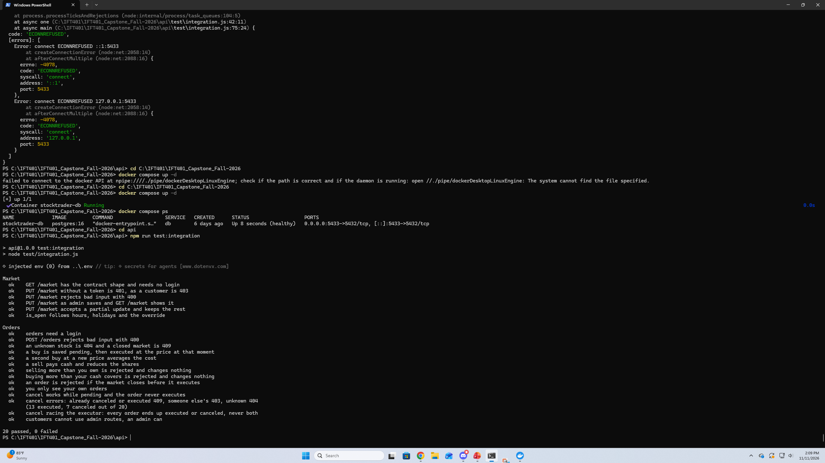
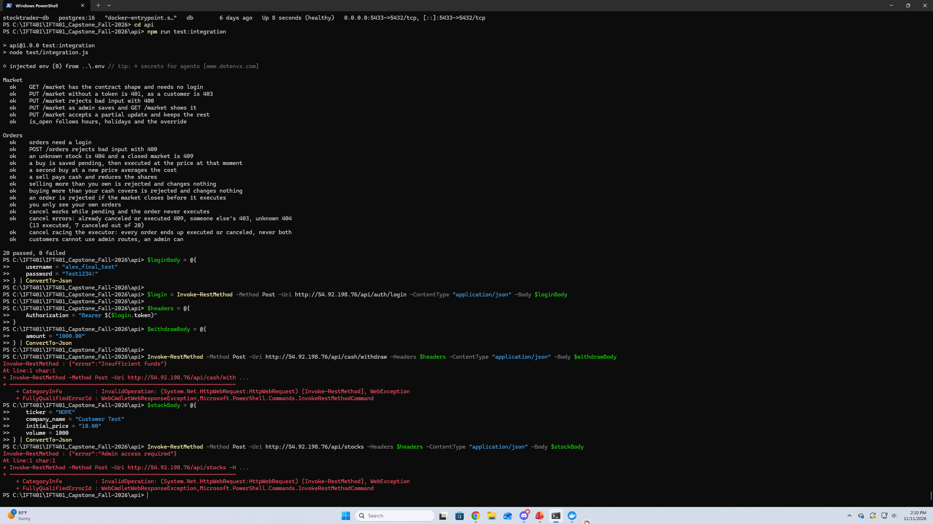
Presenter: Alex
Testing
How we know it works
Automated tests
Fill in: The completed system passes all 20 integration tests. They check market-hour logic, user login, administrator access rights, creating and canceling orders, cancellation race conditions with execution, depositing and withdrawing cash, portfolio information, trade history, and creating stocks.
Route testing
Fill in: Each API route was validated against the API contract through PowerShell and integration tests. Correct requests resulted in returning a 200 or 201 response code. Validation failures and authorization errors correctly returned 400, 401, 403 and 409 response codes when applicable.
End-to-end on AWS
Fill in: The entire deployed application was tested using the live AWS site. Account registration/login, adding/removing cash, buying/selling stocks, canceling pending orders, viewing portfolio/history, creating stocks (as admin), and setting market hour changes were tested.
Notes:
Alex, what to say: run the integration tests on a laptop (never on the AWS server, since its .env points at the real database), show the pass count, then show a few route checks with their status codes. Finish with the end-to-end walkthrough the team did on the live site.

Slide 24
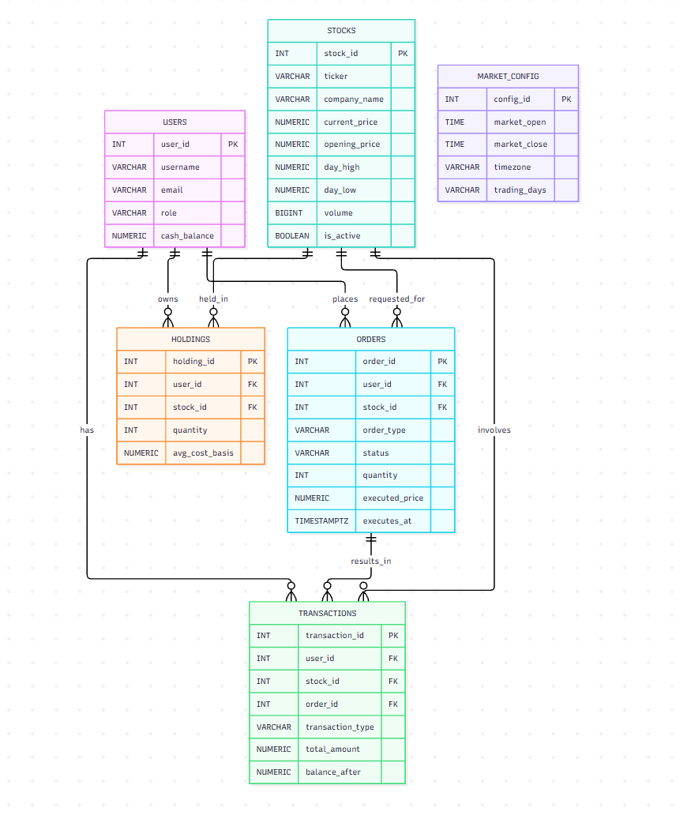
Presenter: Alex
Data model
PostgreSQL, six tables
Tables
Fill in: Tables
users — Accounts, roles, and cash balances.
stocks — Tickers, prices, volume, and status.
holdings — Shares owned and average cost.
orders — Buy/sell orders and execution status.
transactions — Trades, deposits, and withdrawals.
market_config — Market hours, days, holidays, and timezone.
Changes since the SAD
Fill in: Added daily stock pricing fields, delayed-order execution fields, rejection tracking, and full cash/trade history.
Why it holds up
Fill in: PostgreSQL NUMERIC protects money precision, while foreign keys, constraints, and server-side validation keep the data consistent.
Notes:
Alex, what to say: walk through the six tables and how they relate, then the columns that changed since the SAD and why. Mention money is stored as NUMERIC so there are no rounding errors.

Slide 25
Presenter: Kyle
Our biggest accomplishment
A complete trading system running live on AWS, not just on our laptops
Oct 31
20 of 20
0
Deployed and live on AWS, ahead of our Nov 2 to 13 plan
Integration tests pass against a real database
Orders both filled and canceled when we raced cancel against the executor
Why it matters
The company can train brokers today from any browser, with no installs. Every trade is checked on the server and settled in one database transaction, so cash and shares always add up. The design we documented in the SAD held all the way to production, and each teammate's merge reaches the live site in minutes.
Notes:
Our biggest accomplishment is that this is a complete, working trading system running live on AWS, not a demo on a laptop. We deployed it on October 31, ahead of our November 2 to 13 plan. Twenty automated integration tests pass against a real database, including one that races cancels against the order executor, and no order ever ended up both filled and canceled. It matters because the company could start training brokers on it today from any browser, every trade is validated on the server and settled in a single database transaction so the money always adds up, and the architecture we designed in September is the one running in production.

Slide 26
Presenter: Kyle
Our biggest problem and how we solved it
The problem
The business case says a customer can cancel an order before it executes. Our first API draft filled orders instantly, so there was never anything to cancel.
Adding a delay created a harder problem: a cancel and the fill could hit the same order at the same moment, and both could succeed. The customer would get the shares and keep the cash.
How we resolved it
Orders are saved as pending with an execution time a few seconds out.
A timer in the API fills due orders every second. It locks each order row first, rechecks the market, cash and shares, then settles everything in one database transaction.
Cancel only works on a pending order, under the same lock, so only one of the two can win.
We proved it with a test that fires cancels and the executor at once: every order ends executed or canceled, never both.
Notes:
Our biggest problem was cancel. The business case says a customer can cancel an order before it executes, but our first API draft filled orders instantly, so there was never anything to cancel. Adding a delay created a harder problem: a cancel and the fill could hit the same order at the same instant, and both could succeed, so the customer would get the shares and keep the cash. We fixed it in four steps. Orders are saved as pending with an execution time. A timer in the API fills due orders every second, locking each order row first and settling it in one database transaction. Cancel only works on a pending order under that same lock, so only one of them can win. And we proved it with a test that fires cancels and the executor at the same time: every order ends up executed or canceled, never both.

Slide 27
Presenter: Kyle
Other problems we solved
Problem | What we did
Open or closed depended on the viewer's clock and time zone. | The server decides, in Eastern time, from the hours, trading days and holidays; orders and the generator use the same rule.
The pages and API needed different addresses on a laptop and on AWS. | nginx serves both from one address on AWS, and api.js picks the API address from the hostname, so the same code runs in both places.
Seed accounts could not log in: their password hashes were placeholders. | Replaced them with real bcrypt hashes and created the live demo accounts through the API.
Pages and API on different origins made cookie sessions awkward. | Switched to JWT bearer tokens in the Authorization header, with a 4-hour expiry.
Notes:
A few other problems we solved along the way. Market status depended on the viewer's clock, so the server now decides it in Eastern time. The pages needed a different API address on a laptop than on AWS, which nginx and a small change in api.js solved. Our seed accounts had placeholder password hashes, which we replaced. And cookie sessions were awkward across origins, so we used JWT tokens instead.

Slide 28
Presenter: Kyle
Known limitations and future work
Known limitations today
HTTP only: no domain or certificate yet
One EC2 instance and a single-AZ database
No alarm on the price generator itself; systemd restarts it
RDS keeps 1 day of automated backups on the free plan; nightly S3 dumps cover more
The public IP changes if the instance is stopped (no Elastic IP)
What a production version adds
A domain in Route 53 with an HTTPS certificate
A load balancer and Auto Scaling across instances
Multi-AZ RDS for automatic database failover
CloudFront and a web application firewall
Log shipping and a heartbeat alarm for the generator
Tests run automatically on every pull request
Notes:
We scoped this as a free-tier MVP on purpose, so here's what that means. The site is HTTP only, it's one server and one database in one Availability Zone, and nothing alarms on the generator process itself, though systemd restarts it. A production version would add a domain and HTTPS, a load balancer with Auto Scaling, Multi-AZ RDS, CloudFront with a web application firewall, better logging, and tests that run on every pull request.

Slide 29
Presenters: Team (each fills own part)
Lessons learned
Kyle
Design what you can really build. Scoping the SAD to a free-tier MVP held up all semester.
Agree on the API contract early. Three of us built in parallel and swapped mock data for real routes one switch at a time.
Test the risky parts. The cancel-versus-fill test caught problems before AWS.
Daniel
Fill in: 2 or 3 things you learned (technical or teamwork) and what you'd do differently.
Alex
Agree on the API contract upfront. Defining interfaces early made frontend and backend integration much smoother.
Test before merging into main. Testing both success and failure cases helped uncover authentication, database, and validation errors sooner.
Limit branch size and duration. Keeping pull requests small reduced conflicts and made team integration easier.
Notes:
Each of us shares what we learned. Kyle: design what you can actually build; scoping the SAD to a free-tier MVP held up all semester. Agree on the API contract early, which let three of us build in parallel. And test the risky parts: the test that races a cancel against a fill caught problems before we ever deployed. Daniel and Alex: say your own column in 20 to 30 seconds each.

Slide 30
Presenter: Kyle
Questions?
Thank you for watching
Notes:
To wrap up: every function in the business case is built against one API contract, running on a real database, and deployed on AWS. Thanks for watching.

